Slide 1

Data Analysis & Modelling Techniques
Prediction of Calories Burned
Spring 2022 - Project Group 18
Likhit Lingudu
Divija Surepally
Jayakanth Srinivasan
Sai Hruthik Reddy Katipally

Slide 2

Project name: Prediction of Calories Burned | Project champion/leader: Jayakanth Srinivasan
Problem statement: To create a predictive system that predicts the number of calories burned by the users based on their age, gender, etc. | Project goal: The system will predict the number of calories burned for a period when the users have been exercising. The prediction will depend on multiple user factors that vary from one user to another.
Business case: The users will get to know the number of calories they’ve burned. It will help them to lose weight, maintain physical fitness, etc. | Project scope: The predictive model will be trained with open-source historical data. The system will use the model to predict the calories burned using regression.
Team members: Sai Hruthik Reddy Katipally - 1001937465 Likhit Lingudu - 1002027472 Jayakanth Srinivasan - 1001919453 Divija Surepally - 1002027972 | Benefits: Users will know the number of calories burned during their exercise Helps users who are trying to lose weight Self-tracking allows the users to maintain a healthier diet & exercise more.

Slide 3
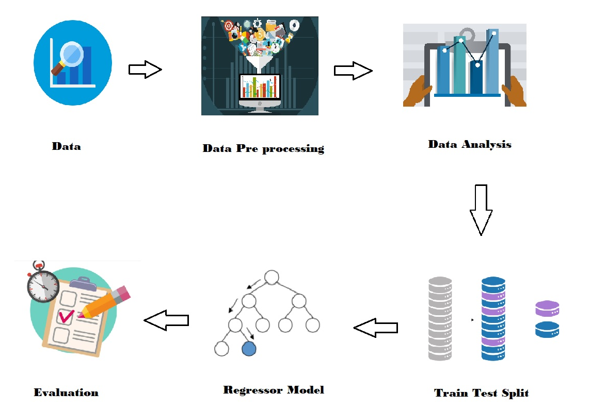
Workflow

Slide 4
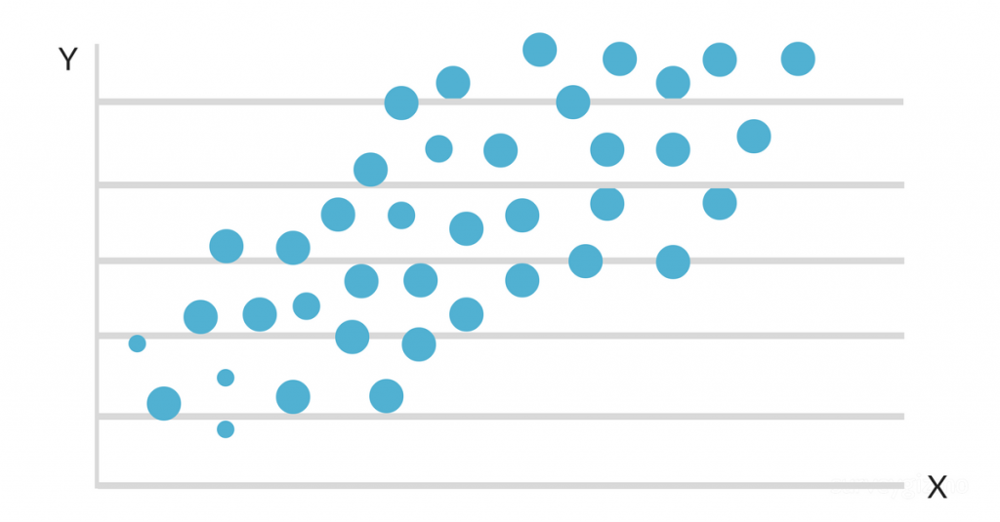
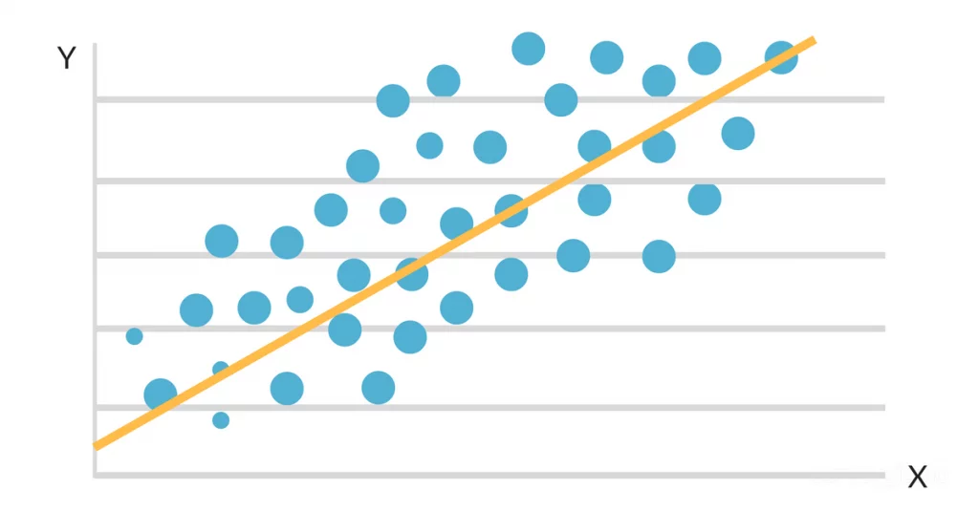
Regression Analysis
Regression Analysis is a set of statistical processes for estimating the relationships between a dependent variable and one or more independent variables.
Dependent Variable: factor that we’re trying to predict. Independent Variables: factors that have an impact on the dependent variable.
It involves plotting the data on a graph and deducing the regression line.
The regression line represents the relationship between independent variable and dependent variable.

Slide 5
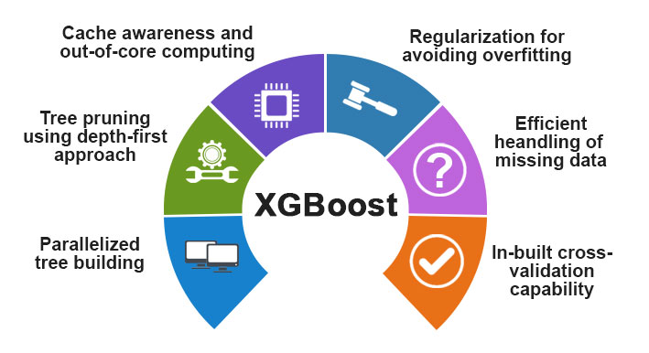
Prediction
A tree-based algorithm called XGBoost Regressor will be used for the prediction.
Higher accuracy and better performance Random Forest algorithm.
Dependent variable: number of Calories burned.
Independent variables: gender, age, height, weight, duration of exercise, heart rate and body temperature.
Dataset: open-source dataset from Kaggle.

Slide 6
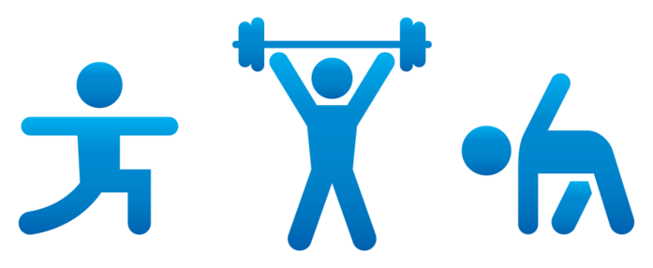
Project outcome:
The model successfully predicts the calories burned using the independent variables.
The Mean Absolute Error of the model is 1.48
The prediction model mean is at 89.34%

Slide 7
THANK YOU

